Slide 1
ATAAPS – Admin Leave (Weather and Safety)

Slide 2
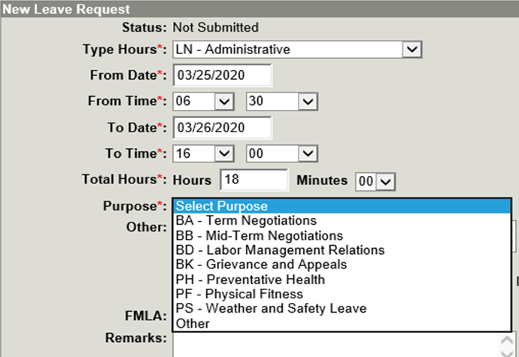

Slide 5
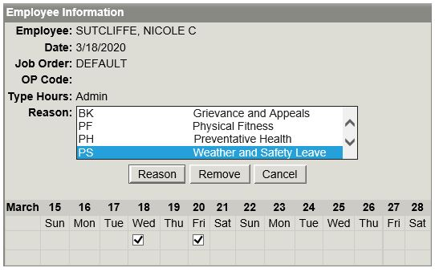
Scroll to find “PS Weather and Safety Leave”
Select all applicable days
Click Reason

Slide 6
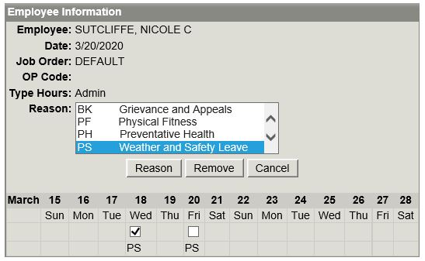
Save and concur as normal
To REMOVE Admin Leave
Click on PS
Ensure the correct day(s) are checked
Click Remove button

